Slide 1
Software Architecture
Software Product Line
Lecturer: Xiaobin Xu
Software Systems Architecture
Lecturer: Xiaobin Xu

Slide 2
Software development
Develop from scratch
Develop via reuse
Methods and functions
Classes and libraries
Component
Subsystem
Software Systems Architecture
Lecturer: Xiaobin Xu

Slide 3
software product line
A software product line organization builds and (re)uses assets, but the assets are all targeted at products within the well-defined scope.
We will reuse anything (code, documentation, tests,…) as long as it is
useful in building the products within the
scope of the product line.
Our goal is not reuse, our goal is to produce
products quickly and economically.
Software Systems Architecture
Lecturer: Xiaobin Xu

Slide 4
software product line
Some real numbers
Improved productivity
by as much as 10x
Increased quality
by as much as 10x
Decreased cost
by as much as 60%
Decreased labor needs
by as much as 87%
Decreased time to market
by as much as 98%
Software Systems Architecture
Lecturer: Xiaobin Xu

Slide 5
Focus on Innovation
Innovation in a software product line is facilitated by allowing the product manager to quickly dispense with that portion of product implementations covered by the core asset base and focus on innovation.
Software Systems Architecture
Lecturer: Xiaobin Xu

Slide 6
What makes SPL different?
There are product management techniques that plan a series of products that share features.
There are software engineering techniques that
share code among products.
The software product line strategy is the first to integrate the two so that shared features are implemented by shared code in a set of products and in an organization structured to make product production effective and efficient.
Software Systems Architecture
Lecturer: Xiaobin Xu

Slide 7
Product Line Definition
A software product line is a set of software-intensive systems sharing a common, managed set of features that satisfy the specific needs of a particular market segment or mission and that are developed from a common set of core assets in a prescribed way.
The product line technique builds different models of a product using common assets
Software Systems Architecture Lecturer: Xiaobin Xu

Slide 8
Product Line Definition
A frequent misconception is that the core assets, the reusable pieces, are the product line. As you can see from the definition, the product line comprises the products.
Product line is a set of products that
address a particular objective
Using product line to build a product is economic and efficient. Most work is about integration instead of creation.
Software Systems Architecture Lecturer: Xiaobin Xu

Slide 9
Product Line Definition
Example: The components of Boeing
757 and 767 are 60% in common
Example: The components in different models of M. Benz E class may be over 70% in common.
Software Systems Architecture
Lecturer: Xiaobin Xu

Slide 10
Product Line Definition
common set of core assets
A “core” asset is anything used to produce multiple products
Source code
Software architecture
Test infrastructure, test cases, and
test data
Production plans
….
Software Systems Architecture
Lecturer: Xiaobin Xu

Slide 11
Product Line Definition
The assets are designed to handle the range of variability defined in the product line scope
Each asset is accompanied by an attached process, which explains how to use the asset in building a product.
Software Systems Architecture
Lecturer: Xiaobin Xu

Slide 12
The payoff
Initiating a software product line strategy requires some amount of up-front investment although it can be minimal.
If the commonality is sufficiently high, payback can happen after a relatively small number of products.
Many organizations have reached the payoff point
Software Systems Architecture
Lecturer: Xiaobin Xu

Slide 13
The payoff
Current Practice
Cumulative Costs
With Product Line Approach
Numbers of Products
Software Systems Architecture
Lecturer: Xiaobin Xu

Slide 14
Philips Medical
Goals: Improved time to market and consistent and integrated behavior of applications.
Achieved
2-4 times effort reduction.
Reduction to less than 50% time-to-market.
Product defect density to 50% of original rate.
Ease of feature propagation from one product to others.
Common look-and-feel.
Better product planning & use of roadmaps.
Software Systems Architecture Lecturer: Xiaobin Xu

Slide 15
Philips Medical
The primary asset is the product line architecture
Architecture supports distributed development
that will still work seamlessly when integrated
Philips has developed their core asset base through an innovative approach to open source referred to as “inner source”
Different business units contribute to the development of the core assets
Software Systems Architecture
Lecturer: Xiaobin Xu

Slide 16
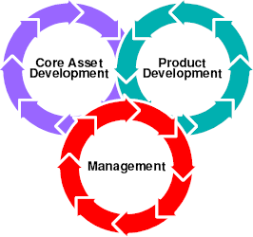
How’s it done?
Essential activities
Core asset development
Product development
Management
Software Systems Architecture
Lecturer: Xiaobin Xu

Slide 17
Core asset development
What can we profitably reuse?
How many products will use it?
How much extra will it cost to make it reusable?
We reuse ANYTHING that makes sense (money)
Source code – obviously – but non- software assets also
For example, we decompose a test suite into individual test cases, then compose as needed by a product
Software Systems Architecture
Lecturer: Xiaobin Xu

Slide 18
Core asset development
A team is devoted to providing these
assets
This team has a vision that encompasses all products that would use its assets.
An “attached process” accompanies each core asset to facilitate reuse of the asset
Software Systems Architecture
Lecturer: Xiaobin Xu

Slide 19
Product development
Product development is combining core assets with product-specific artifacts to produce products.
Product development moves faster than in traditional development because of the assets and the small percentage of product-specific artifacts.
A product team may continue to own the product it has built or it may hand it off to a maintenance team.
Software Systems Architecture
Lecturer: Xiaobin Xu

Slide 20
Management
A central authority, such as a product line manager, oversees the organization which may cut across multiple business unit boundaries
Coordinates the production of core assets and the assembly of products.
Ensures that resources are available at the right time to optimize operation of the production capability.
Software Systems Architecture
Lecturer: Xiaobin Xu

Slide 21
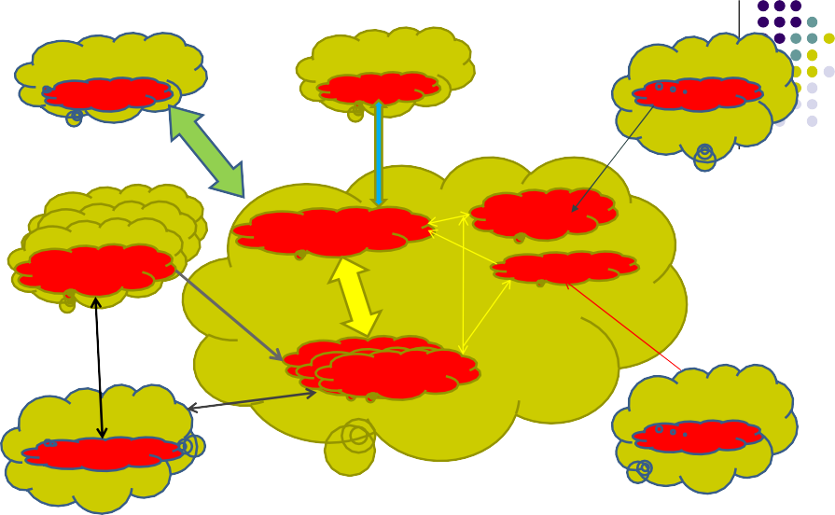
Strategic partner
Product team
Parent organization
$$$
Asset source
Open source
Core asset team
Configuration management
Product mParondaugcetme mParondaugncet tme
managnetment
Software architecture
Product Line organization
P_{P}ro_{r}d_{o}u_{d}c_{u}t_{ct}
Product
te_{t}a_{e}m_{am}
team
Customer
requirements
Domain organization
Reference architecture
Software product line ecosystem
Software Systems Architecture
Lecturer: Xiaobin Xu

Slide 22
Software product line
a product line consists of:
multiple systems, which have the same architecture and share common core assets
variability among systems
To produce a product from a product line, the product line should be instantiated through the following two steps:
Selection: unneeded functionality (i.e, assets) is stripped, needed assets are selected, variability are solved
Software Systems Architecture
Lecturer: Xiaobin Xu

Slide 23
Software product line
Extension: addition assets are added for the remaining variation points (possibly created from scratch)
Software Systems Architecture
Lecturer: Xiaobin Xu

Slide 24
Software product line
Selection is an essential step in producing a product from a product line. The problem is how to select assets from a product line?
Possible solution: based on keywords, attributes, behaviors, and so on.
Currently, the most popular approach is based on features.
Software Systems Architecture
Lecturer: Xiaobin Xu

Slide 25




Software Product Lines
component set
product-line
architecture
external
internal
...
product 1
product 2
product n
25
Software Systems Architecture
Lecturer: Xiaobin Xu
Introducting software product lines

Slide 26
Key ingredients
Business case
Software architecture
Variability management
Software Systems Architecture
Lecturer: Xiaobin Xu

Slide 27
Software architecture
Perhaps the key core asset
Captures early decisions about solving the problem
Communication vehicle among the stakeholders
Explicitly addresses the quality attributes
Reliability
Security
Dependability
Software Systems Architecture
Lecturer: Xiaobin Xu

Slide 28
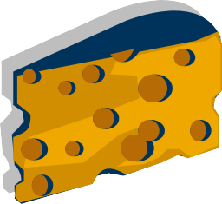
Product line architecture
The product line architecture is the architecture for a family of systems
Is more abstract, not every thing is completely defined
There are holes in its specification, but the architecture constrains how the holes can be filled
Software Systems Architecture Lecturer: Xiaobin Xu

Slide 29
Variation
Products vary from one another in specific ways - the allowable contents of the holes in the architecture.
Strategic variations at the business unit level.
Tactical variations at the technical manager’s level
Variation points at the implementation level.
Software Systems Architecture
Lecturer: Xiaobin Xu

Slide 30
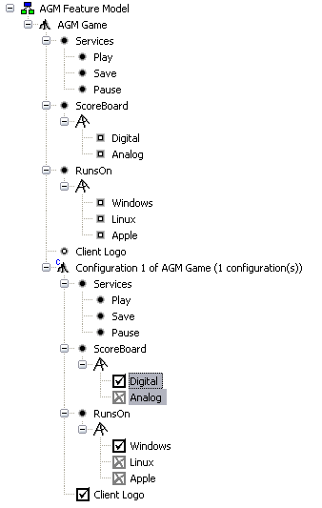
Commonality/Variability Analysis
What do the products in the product line have in common?
How are they different?
A configuration is a selection of inclusive and exclusive OR feature choices to completely define a single member of the product line.
Software Systems Architecture
Lecturer: Xiaobin Xu

Slide 31
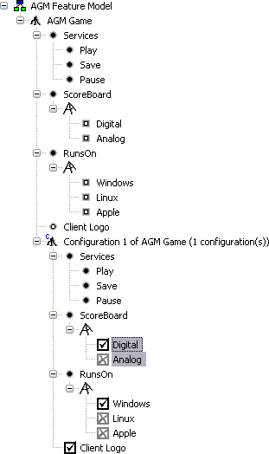

Product architecture
Each hole is plugged by a specific variant
determined by the features selected.
3
1
2
Software Systems Architecture
Lecturer: Xiaobin Xu

Slide 32
Example (software systems)
For a bank system product line, you can select the features: deposit, withdraw, loan, remit, foreign currency exchange, and so on. According to the features you selected, a specific bank system can be produced for you. Variability should be solved sometimes, such as what kinds of foreign currency exchange are allowed.
Software Systems Architecture
Lecturer: Xiaobin Xu

Slide 33
Software product line vs. individual systems
When a core asset is changed, the change reflects to every system within a product line.
Product line can be evolved (e.g., a product line may be ported to the Internet). When evolving a product line, all the systems within the product line are evolved
Individual systems cannot obtain the
above benefit.
Software Systems Architecture
Lecturer: Xiaobin Xu

Slide 34
Software product line vs. individual systems
If a common component is changed (or added), every system in the individual systems should be changed (extended).
The work is cumbersome if there are many (e.g., 1000) individual systems.
Software Systems Architecture
Lecturer: Xiaobin Xu

